Slide 1

Seminar on AI & Technology Innovation
Dr James CHAU
29 July – 31 July 2024

Slide 2
Topic
Wireless IoT Technologies and Applications (29 July 2024)
SoLoMo = Social + Local + Mobile (30 July 2024)
Serving the community with Engineering knowledge (31 July 2024)

Slide 3


Lecturer information
Dr. Chau Chun Pong, James
PhD in Electronic and Information Engineering, PolyU
Principal Lecturer of CPCE, PolyU
Associate Division Head of SEHS, CPCE, PolyU
Research Interests:
Image processing, video processing, pattern recognition, artificial intelligence, Integrated circuits, indoor positioning, robotics.
Tel: 3746 0237
Email: ccjames@cpce-polyu.edu.hk

Slide 4
Day 2: SoLoMo = Social + Location + Mobile
Overview
Introduction to SoLoMo
Evolution of SoLoMo
The SoLoMo Ecosystem
The power of social, local and mobile
Implementation SoLoMo in business

Slide 5
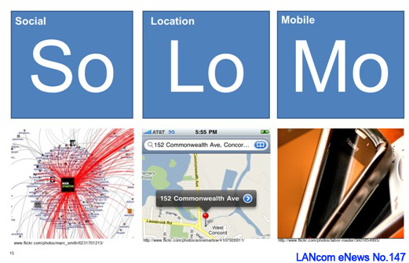
Overview
In this seminar, we will explore the concept of the Social+Local+Mobile (SoLoMo) marketing strategy, its importance in the digital age, and how to effectively implement it in your business.

Slide 6

Overview
With the breakthrough of the digital technologies, the people’s living becomes more convenient, and they can process many things through Internet
Banking
Purchasing
Learning
Entertainment
However, when everyone uses the
Internet to do business, how to get success?
SoLoMo is a way to go!

Slide 7

What is SoLoMo?
Traditional sales and marketing
Advertisement on media
Personal selling / direct mail
Cold calling
Spokesperson
Trade show and exhibition
The key characteristics of traditional sales and marketing are that they rely heavily on human interaction, mass communication channels, and push strategies
Not so effective nowadays!

Slide 8
What is SoLoMo?
With the growth of the Internet usage, people spend more time on it
How to do sales and marketing in the Internet?
SoLoMo = Social + Local + Mobile
Strategy: use of social media to promote the products and services, identify the buyer’s locations through their mobile devices and complete the sales by delivering the products and services to them

Slide 9


Social
Social media platforms and user engagement
They connect people at different locations
Users can communicate each other, entertaining, learning, doing business…

Slide 10
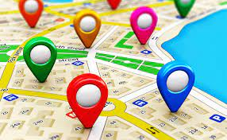
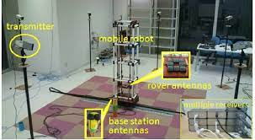
Local
Location-based services and targeting local customers
It provides the services that uses information about the user’s location through the use of GPS, cellular, Wifi, etc.

Slide 11
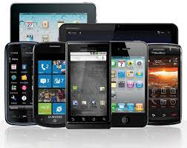
Mobile
Mobile devices and the role of mobile technology
They are the devices that can make the users communicate in the social media and transmit the signals at anywhere
Users make use of the mobile technology to assess the information in the Internet and give their response / commands to achieve their purposes

Slide 12
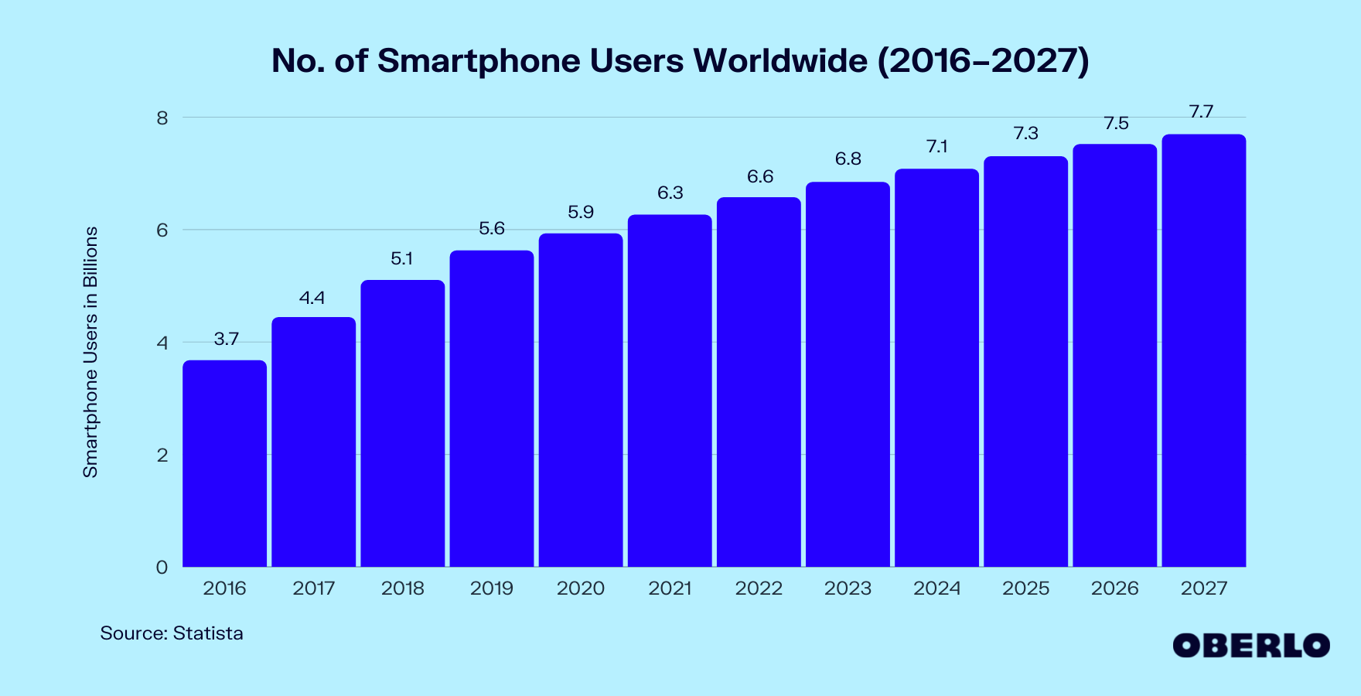
The significance of SoLoMo in the digital era
No. of smart phone

Slide 13
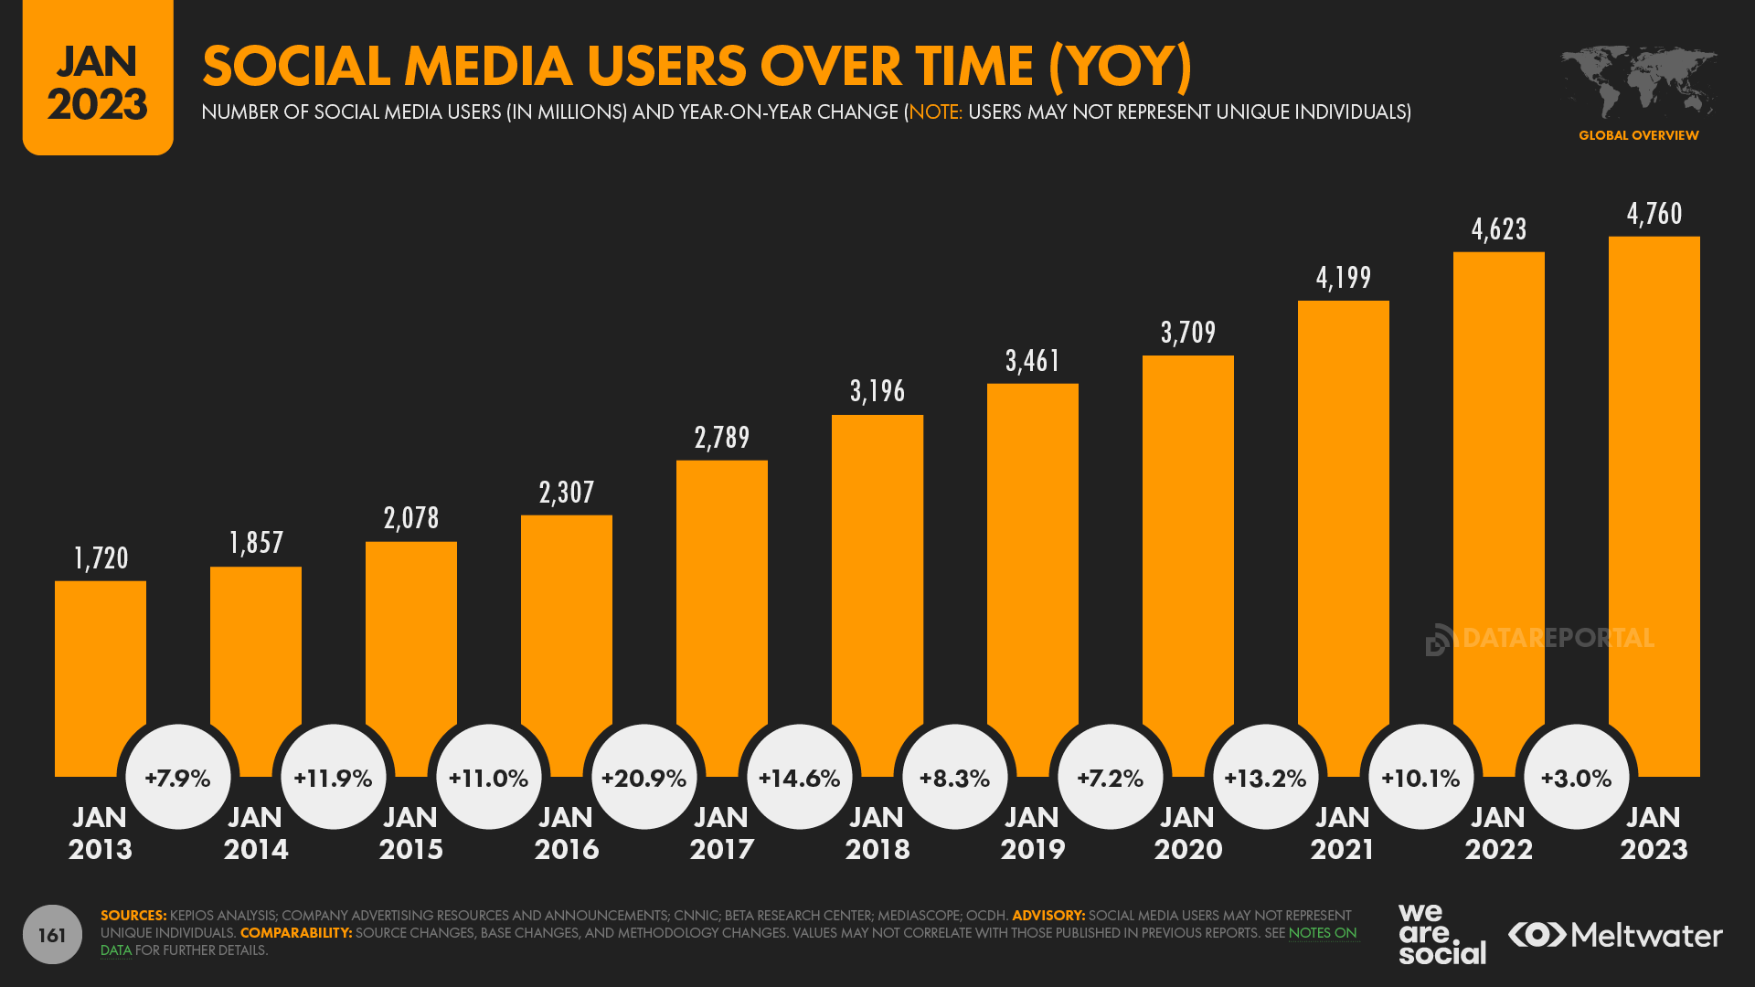
The significance of SoLoMo in the digital era
No. of social media user

Slide 14
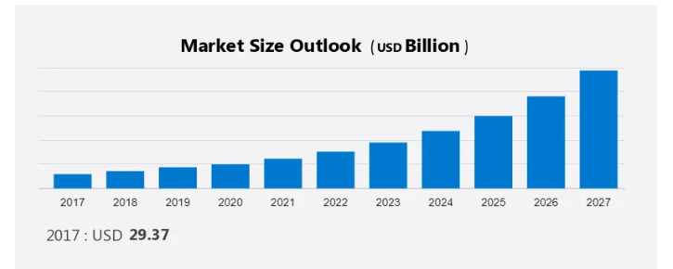
The significance of SoLoMo in the digital era
LBS business forecast

Slide 15

The significance of SoLoMo in the digital era
Observations:
The customers shift towards mobile devices
The proliferation of location-based services
The growing importance of social media engagement
Digital marketing
Search engine
KOL / Blogger
Apps

Slide 16
Evolution of SoLoMo
With the growth of Internet in 199x, SoLoMo serves the community separately
The rise of social media and social networking and people are increasingly connected to friends
The growth of location-based services that are aware of a user's physical location, e.g. navigation
The rapid adoption of smartphones and other mobile devices. Mobile phones have become the primary device for accessing the Internet and apps for many people.

Slide 17
Evolution of SoLoMo
These three trends have evolved and converged over the last decade or so, enabling a range of new applications and services:
Social networking applications that allow you to check in at locations and share your location with friends. For example, posting on Facebook or Twitter from a specific place.
Location-based social networking services like Foursquare that let you interact with friends who are also nearby.
Mobile apps that take advantage of a user's social graph and location to provide relevant information, deals and recommendations. For example, finding what friends recommend at nearby restaurants.

Slide 18


Evolution of SoLoMo
The ability for businesses to engage with customers through social media and target advertising to people within a certain location. For example, offering deals to users who check in.
New forms of location-based gaming that incorporate a player's social network and real-world environment.
Improved event organization tools that make use of people's locations, friend connections and mobile devices.

Slide 19
The SoLoMo Ecosystem
Social media platforms

Slide 20





The SoLoMo Ecosystem
Location-based service providers

Slide 21





The SoLoMo Ecosystem
Mobile technology providers

Slide 22

SoLoMo example
https://www.youtube.com/watch?v=5bemF2jdk9A

Slide 23
SoLoMo infrastructure generation
Digital map creation
GPS/Wi-Fi fingerprint positioning
Wi-Fi signal survey
Visual 360 maps
360 video capture
Software development kits and end user applications

Slide 24
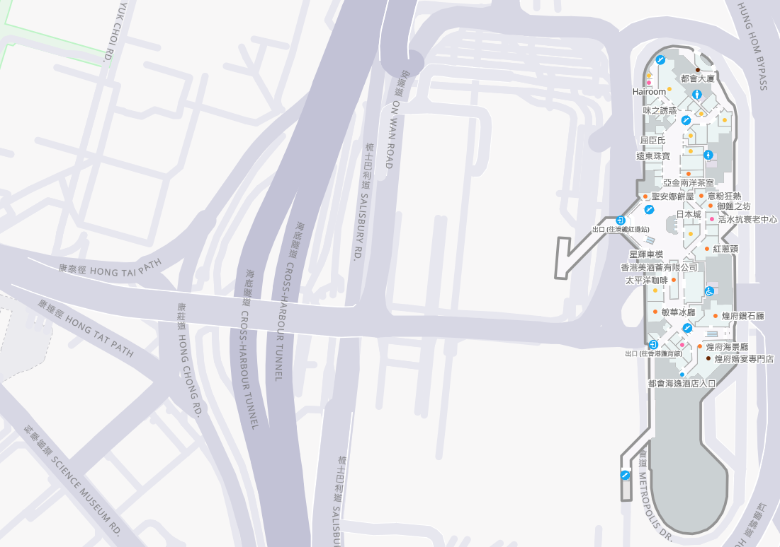
Introduction to Digital Mapping
Digital maps are the digital representation of the real world
They can be used to tell the users the geographic information
E.g. Google map, Apple map,
Baidu map, Mapxus
Demo:
https://maps.google.com
https://anywhere.mapxus.com/

Slide 25
Digital mapping tool
A digital mapping tool allows the user to create geographical display data.
It comes with a Geographical Information System (GIS) that allows a geospatial analysis and visualization of specific locations.
E.g. Cell Sketch – it is a digital mapping tool created by Maphive Technology Ltd. It includes many layers of data, such as structural, point of interest, navigation, positioning and visual data. Its output can be integrated with the Indoor Mapping Data Format used by Apply Maps.

Slide 26
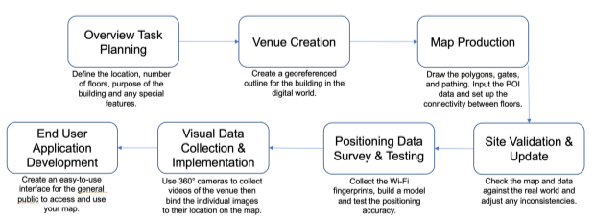
Work-flow of indoor digital map production

Slide 27
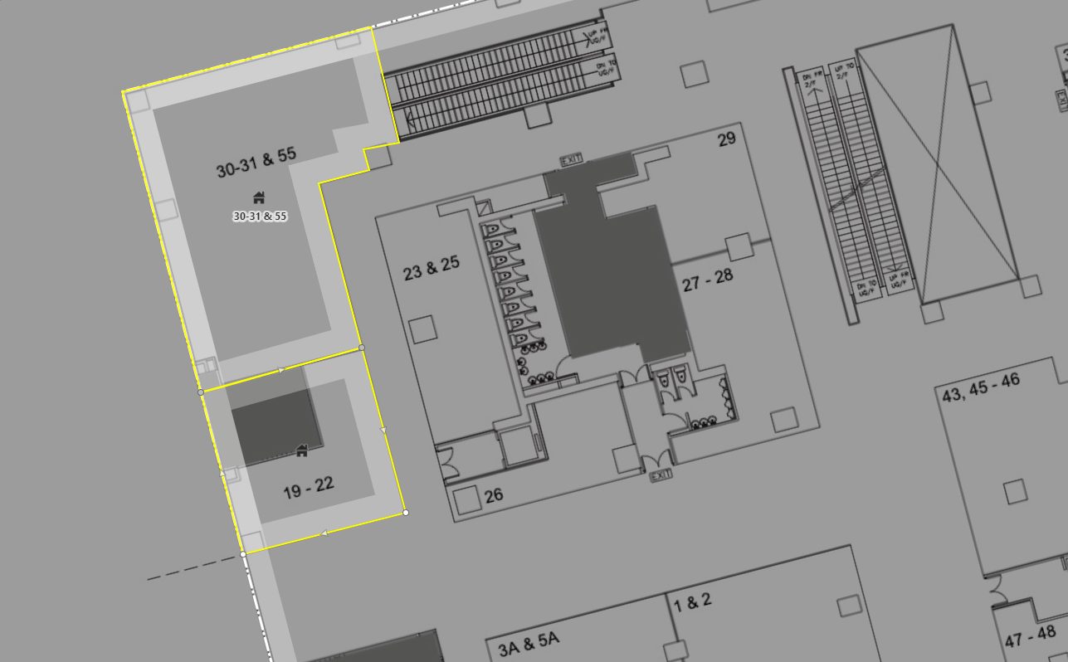
A map production demonstration
Cell sketch: https://cse-test.mapxus.com

Slide 28

Introduction to Points of Interest (PoI)
PoI refers to the digital representation of physical locations that individuals may find helpful or interests, e.g. retail stores, washrooms, visitor center, etc.
They store the information such as the names, addresses, geographical coordinates, category classification, contact information, etc.
What will a restaurant store in its PoI information?

Slide 29
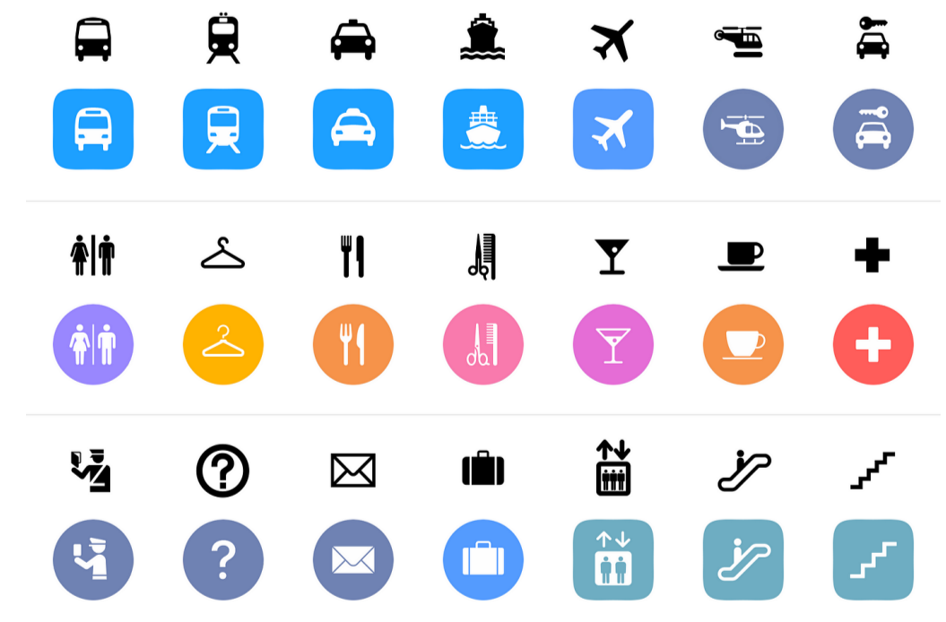
Source of PoI data
User-generated data, web and media platforms
Onsite data
Official government sources
Public directories

Slide 30
How is PoI represented in digital maps?
Icons and symbols
Colour coding
Text labels

Slide 31
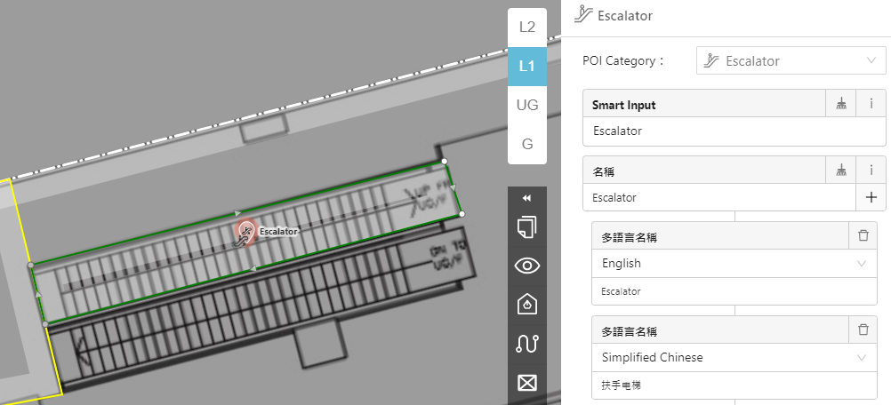
PoI drawing demonstration

Slide 32
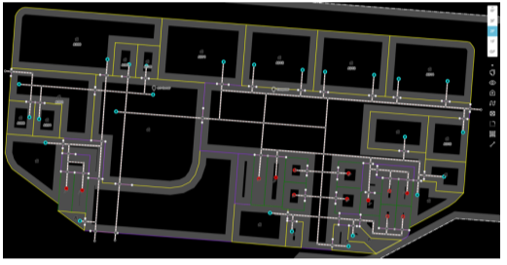
Introduction to pathwebs
Pathwebs mean the pedestrian paths, it helps the pedestrian to travel the environments, guide them to walk and lead them to their destinations.
The pathwebs should be added to the digital maps by the map creators.

Slide 33
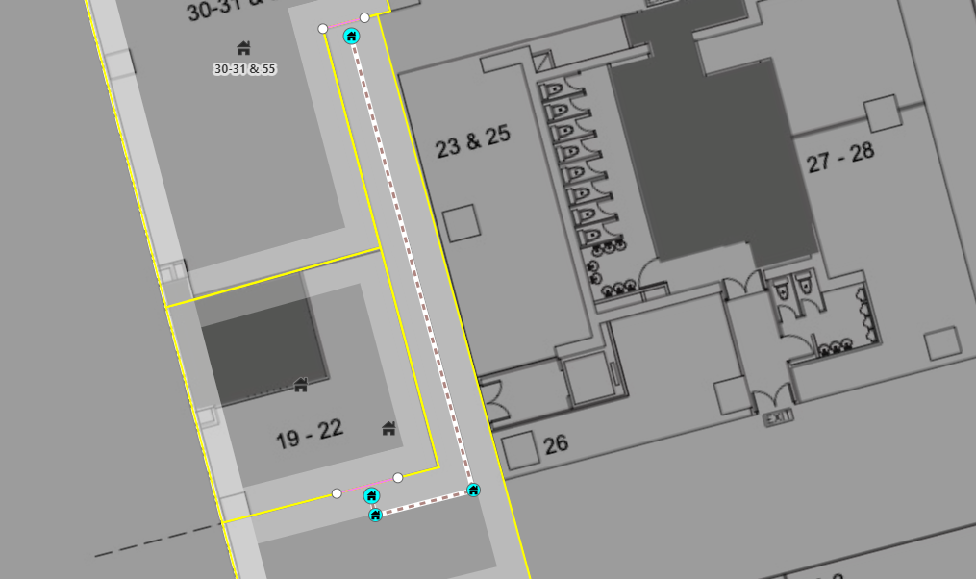
Pathwebs demonstration

Slide 34
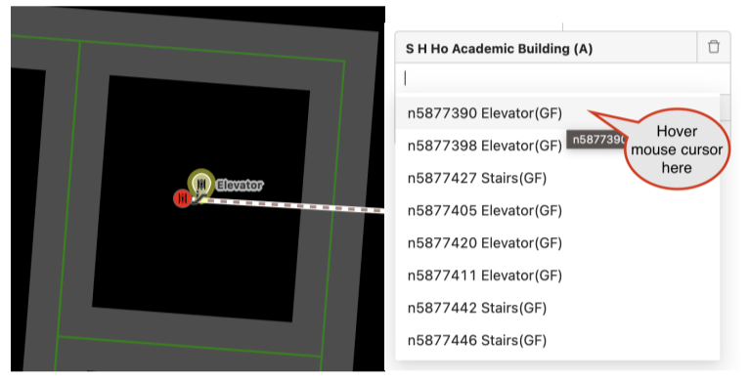
Floor connections
In a building, it often has multiple floors, the paths should be set up for connecting the floors with stairs, escalators, and lifts.

Slide 35
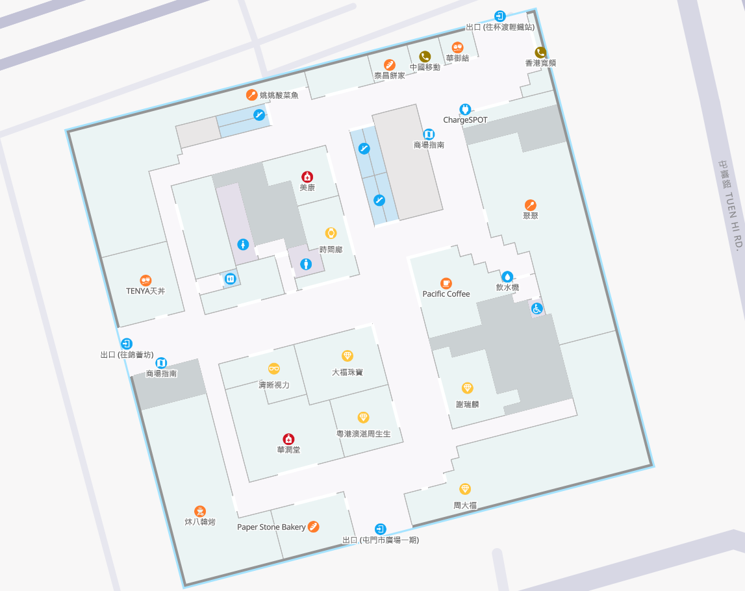
Map result
https://anywhere.mapxus.com/building/tuenmuntownplazaphase2_hk_84c0b3?from=share

Slide 36
Site validation
The process of site validation aims at ensuring the accuracy and alignment of a digital map with the actual physical environment.
The floor plans are checked using a mobile apps in surveys of the real environments.
The apps allows the user to change, add or delete information during the site validation.

Slide 37
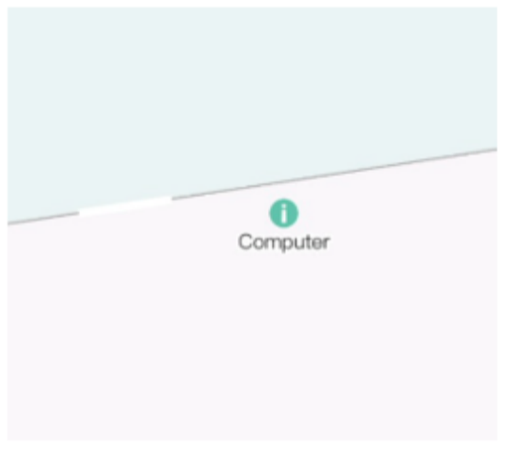
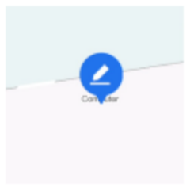
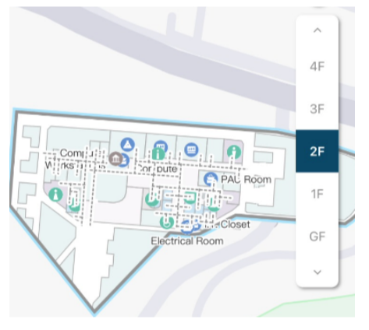
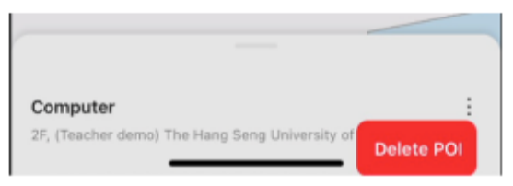
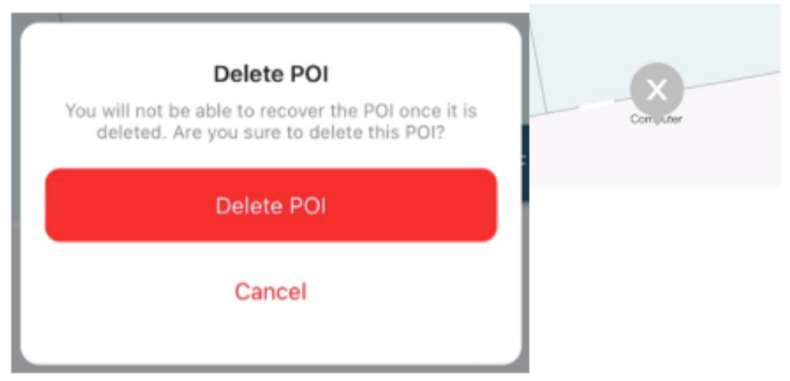
Example

Slide 38
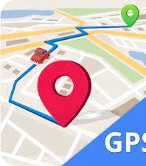

Wifi fingerprint survey
In the outdoor environment, users can employ GPS to locate themselves.
However, GPS is not available in the indoor environment.
Use Wifi fingerprint location to replace GPS as it dose not require the additional infrastructure installation.

Slide 39
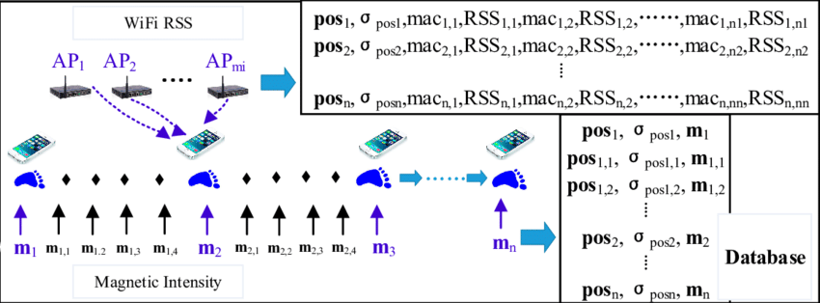
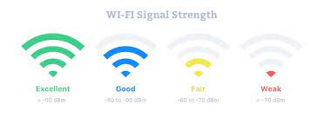
WiFi fingerprint approach
It connects WiFi RSSI from different WiFi Assess Point (AP) at some specific locations in an indoor environment
RSSI is ranged from -50 to -100 dbm.

Slide 40
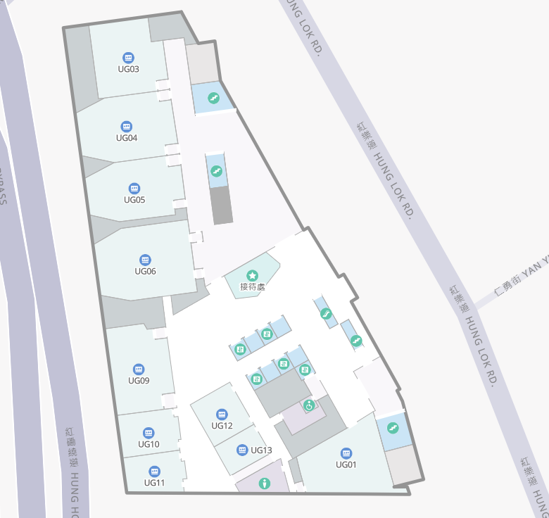
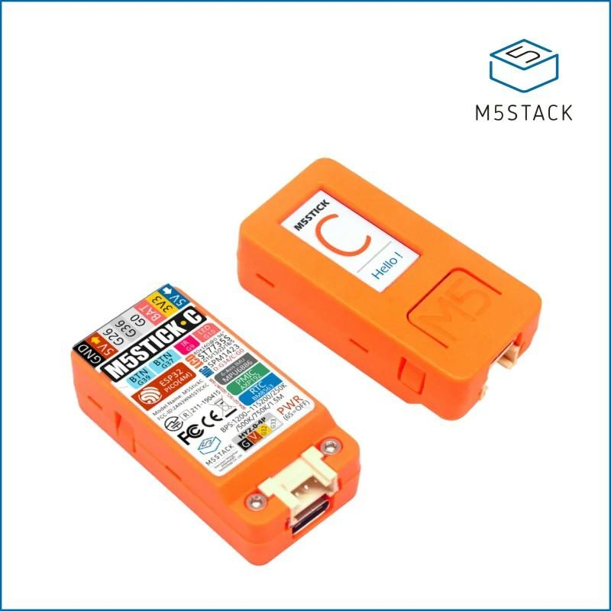

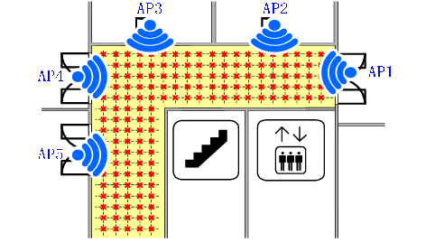
Wifi fingerprint collections
Use walk survey to collect the Wifi signals at some specific locations of the indoor environments.
Digital
map
Query
Radio
map
Response

Slide 41
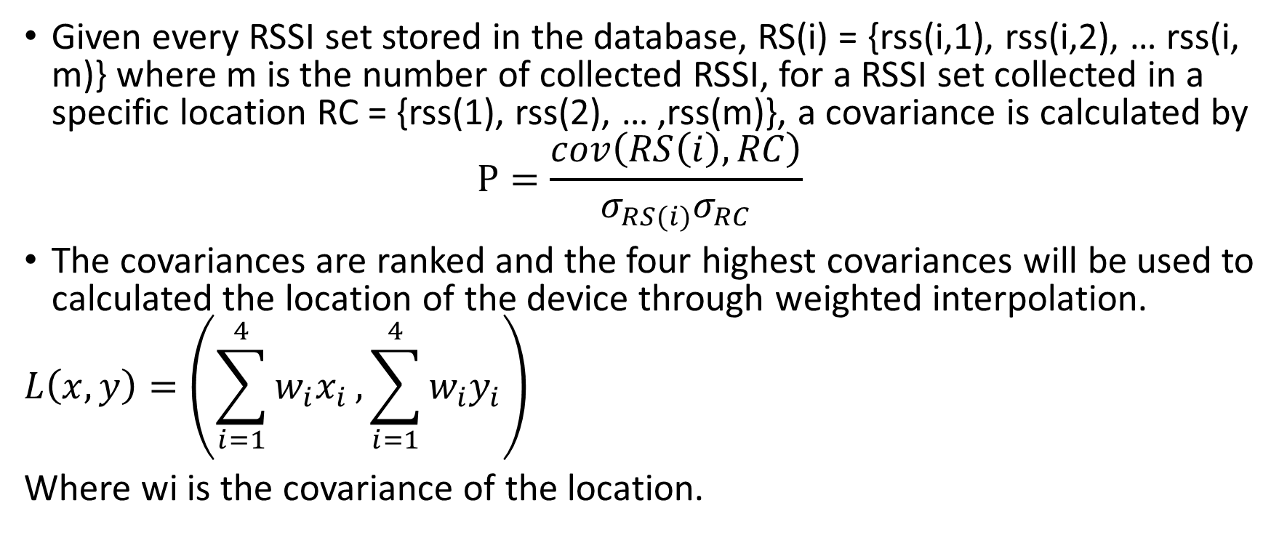
Similarity metric of Wifi fingerprints
Given every RSSI set stored in the database, RS(i) = {rss(i,1), rss(i,2), … rss(i, m)} where m is the number of collected RSSI, for a RSSI set collected in a specific location RC = {rss(1), rss(2), … ,rss(m)}, a covariance is calculated by
$$P=\frac{cov\left(RS\left(i\right),RC\right)}{σ_{RS(i)}σ_{RC}}$$
The covariances are ranked and the four highest covariances will be used to calculated the location of the device through weighted interpolation.
$$L\left(x,y\right)=\left(\sum_{i=1}^{4}{w_{i}x_{i}},\sum_{i=1}^{4}{w_{i}y_{i}}\right)$$
Where wi is the covariance of the location.
Estimation location
Grid point

Slide 42
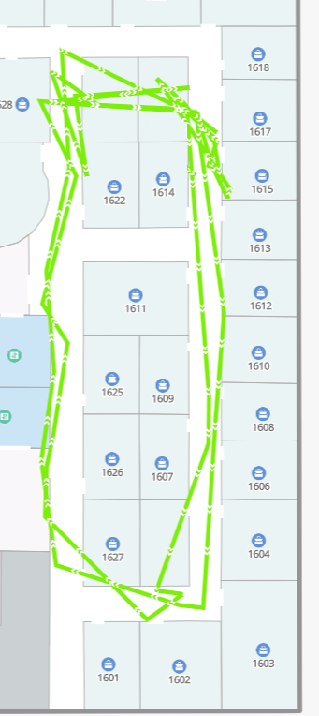
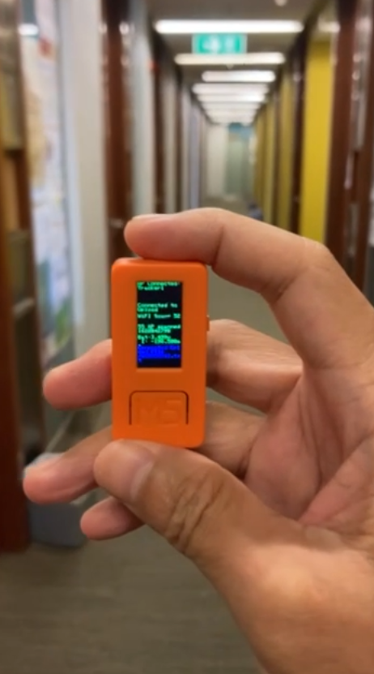
Tracking result
The device can be mobile phones or IoT devices.
The accuracy is around 3-5 m.

Slide 43
Visual maps
A visual map is a series of 360-degree images that are layered over the digital map.
It provides additional visual information on how the actual indoor environment look like.
It can help also locate or navigate the objects or PoI in the indoor environment and eventually produce virtual tours for the indoor environment using the Augmented Reality (AR) or Virtual Reality (VR) technologies

Slide 44
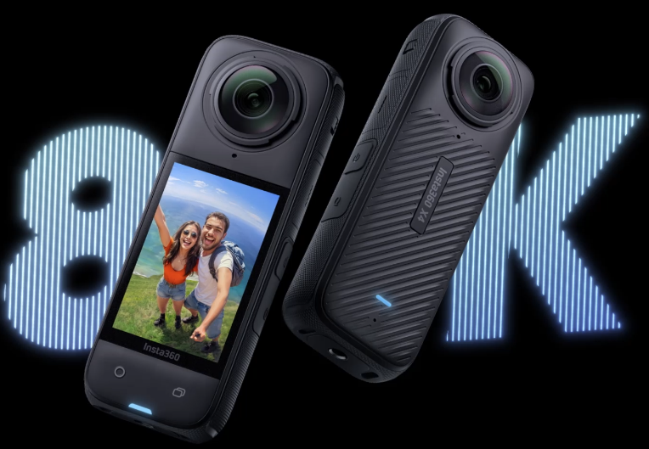
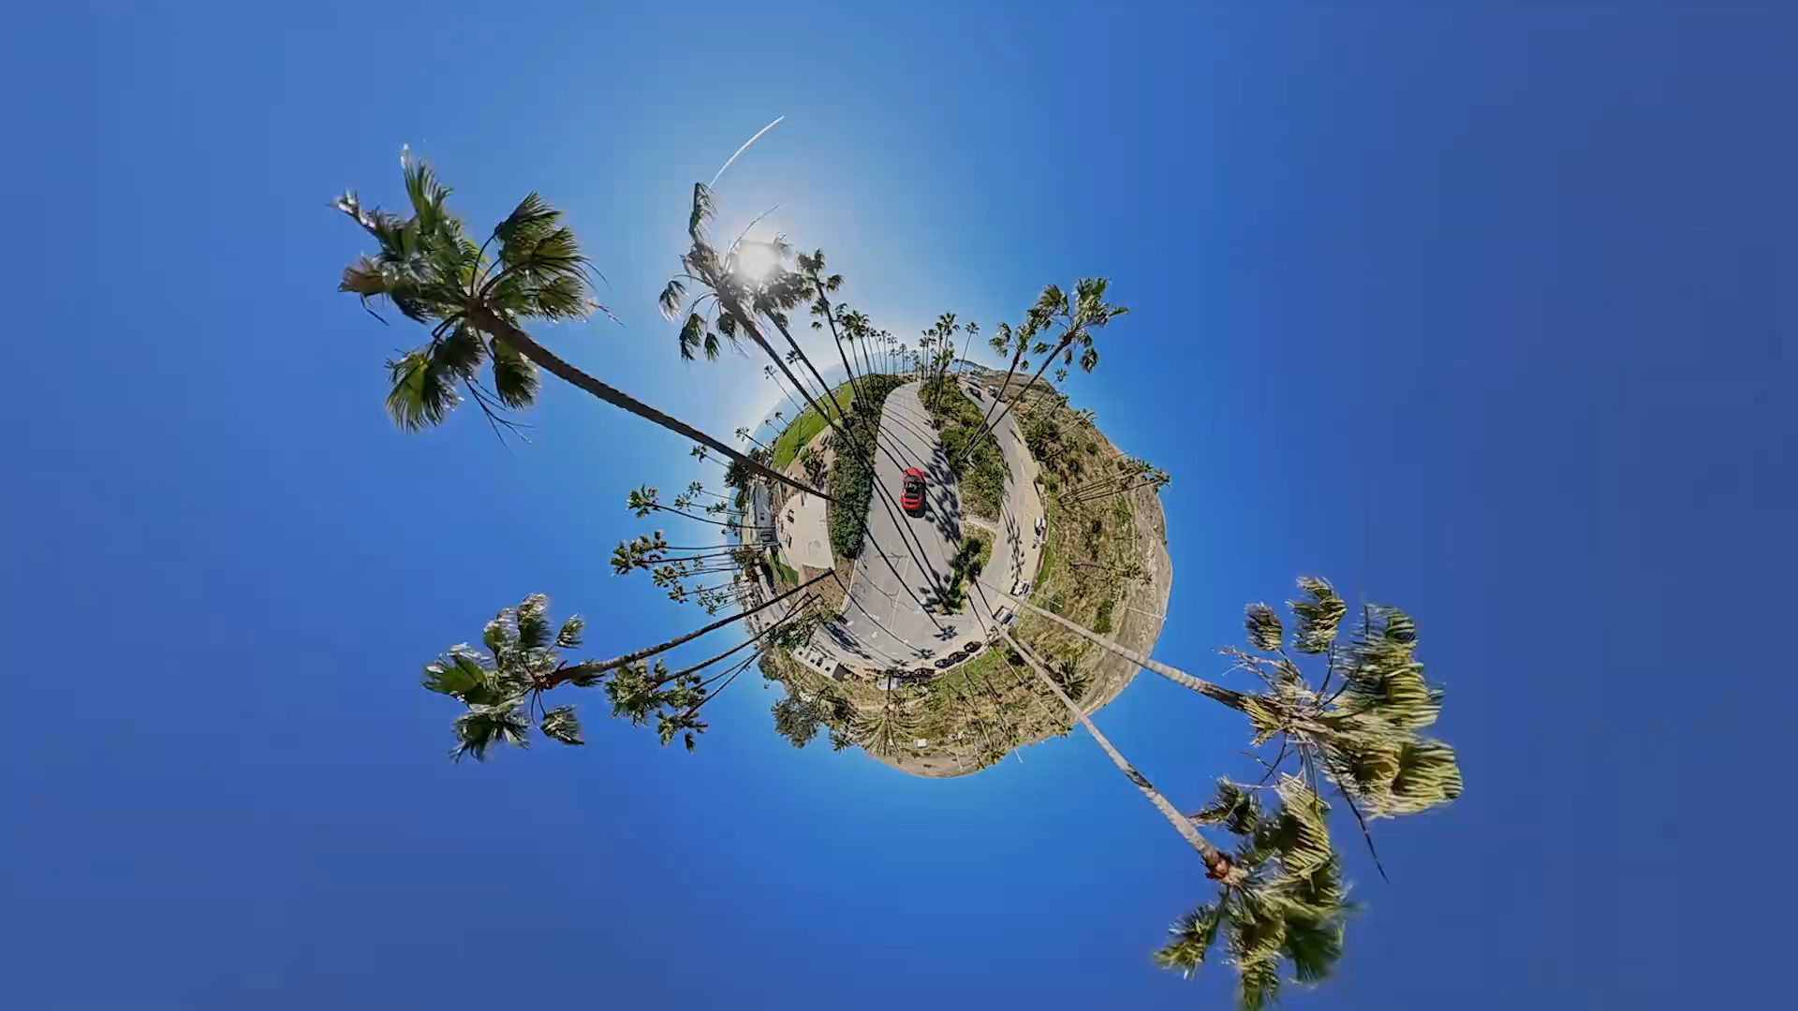
Tool for visual maps
A 360° Camera

Slide 45
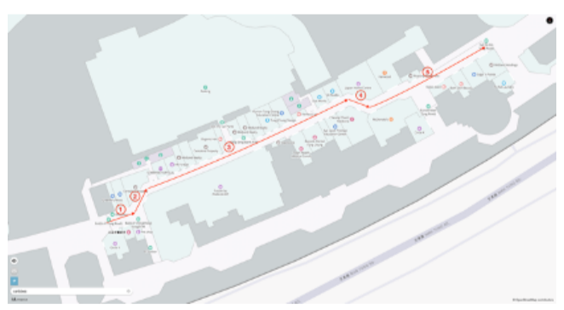
Visual map production
Step 1: plan the route

Slide 46
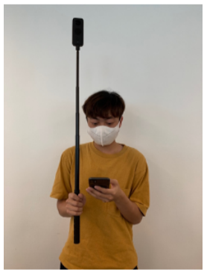
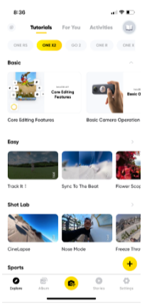
Visual map production
Step 2: setup the 360° camera and its apps

Slide 47
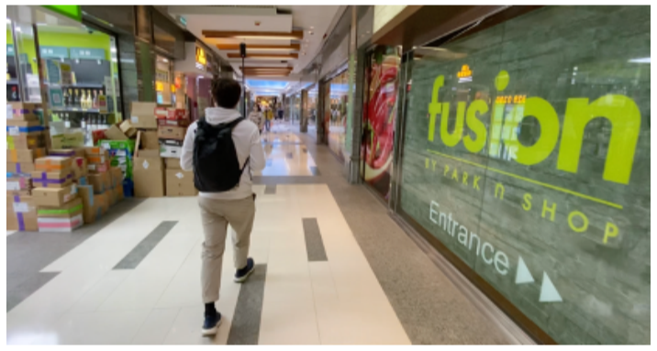
Visual map production
Step 3: perform the walk survey with a straight path and constant speed.

Slide 48
Visual map production
Step 4: Compile the visual maps (demo)

Slide 49
Summary
Introduction to SoLoMo
Evolution of SoLoMo
The SoLoMo Ecosystem
SoLoMo infrastructure generation
Digital maps production demonstration

Slide 50
Thank you…

